Slide 1

VISION STATEMENT
Transformed lives in model green communities anchored on strong moral values where everyone can have better home and better lives. Creating accessible, safe, green model homes in developing countries, such as the Philippines, liberates people to live better, healthier, and more productive lives.

Slide 2
MISSION STATEMENT
We are a group of entrepreneurs committed to transforming lives by building master-planned eco-friendly communities infused with a sense of moral, social and family values and responsibility; empowering its residents in the area of stewardship—in education, health and livelihood, in order to give them a sense of destiny. We shall partner with public and private sectors, both local and international, that share the same vision.

Slide 3



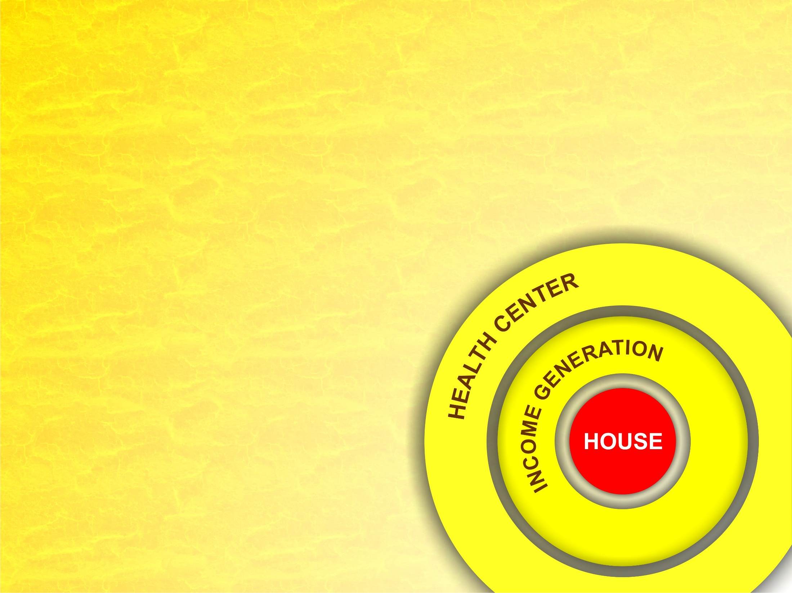
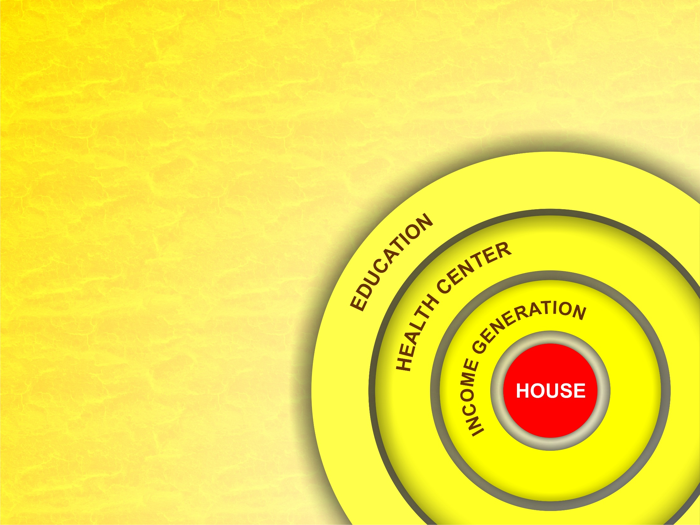
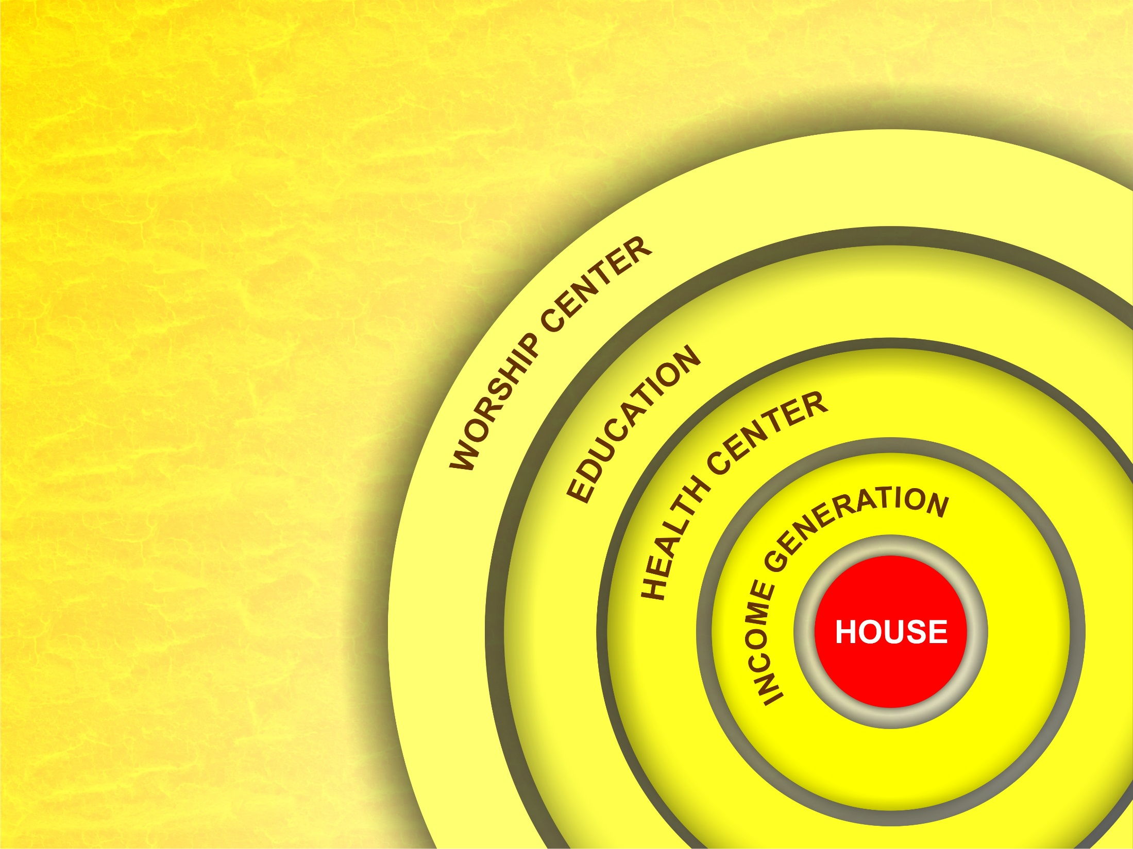
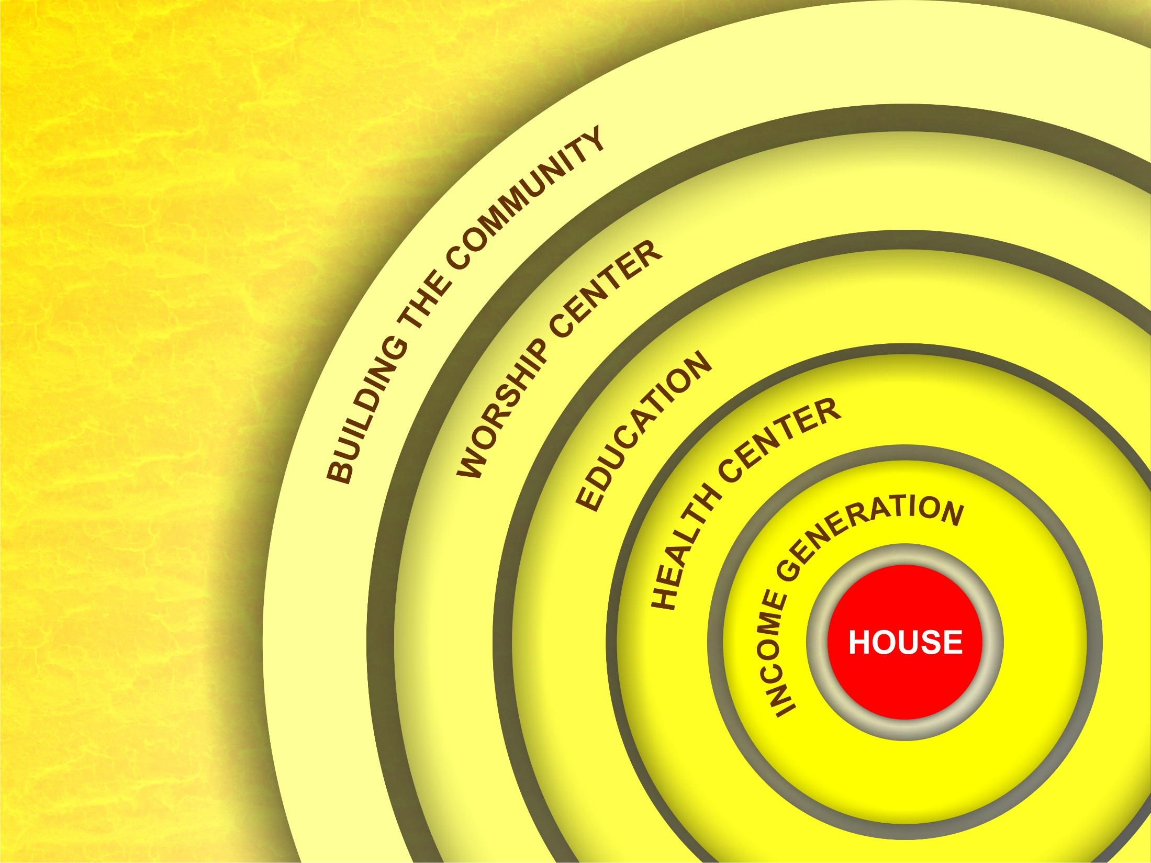
Community engagement

Slide 4
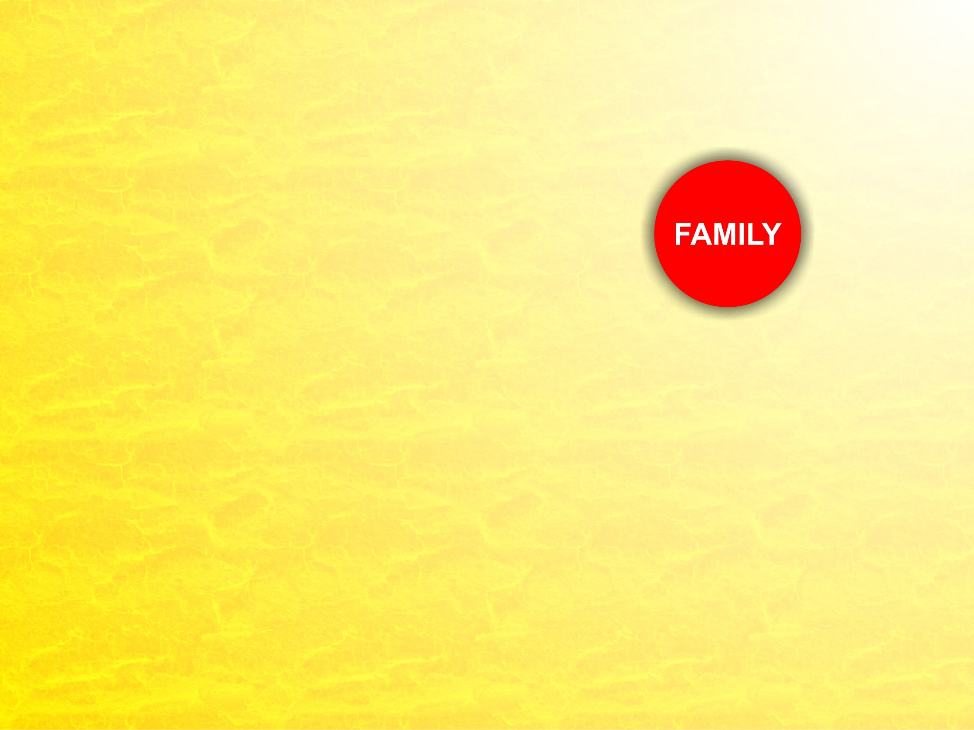
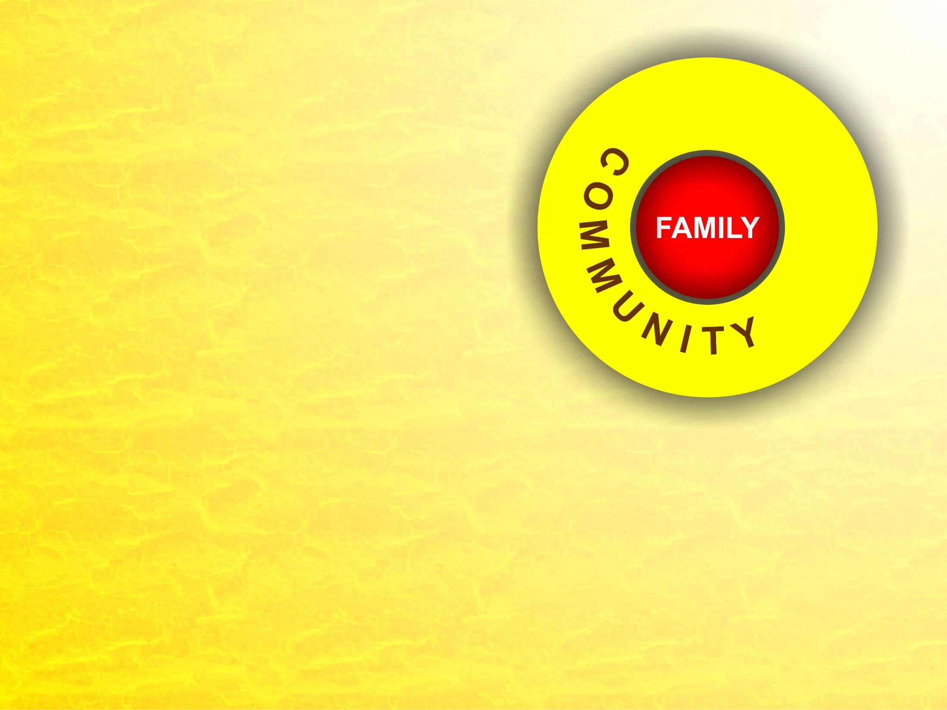
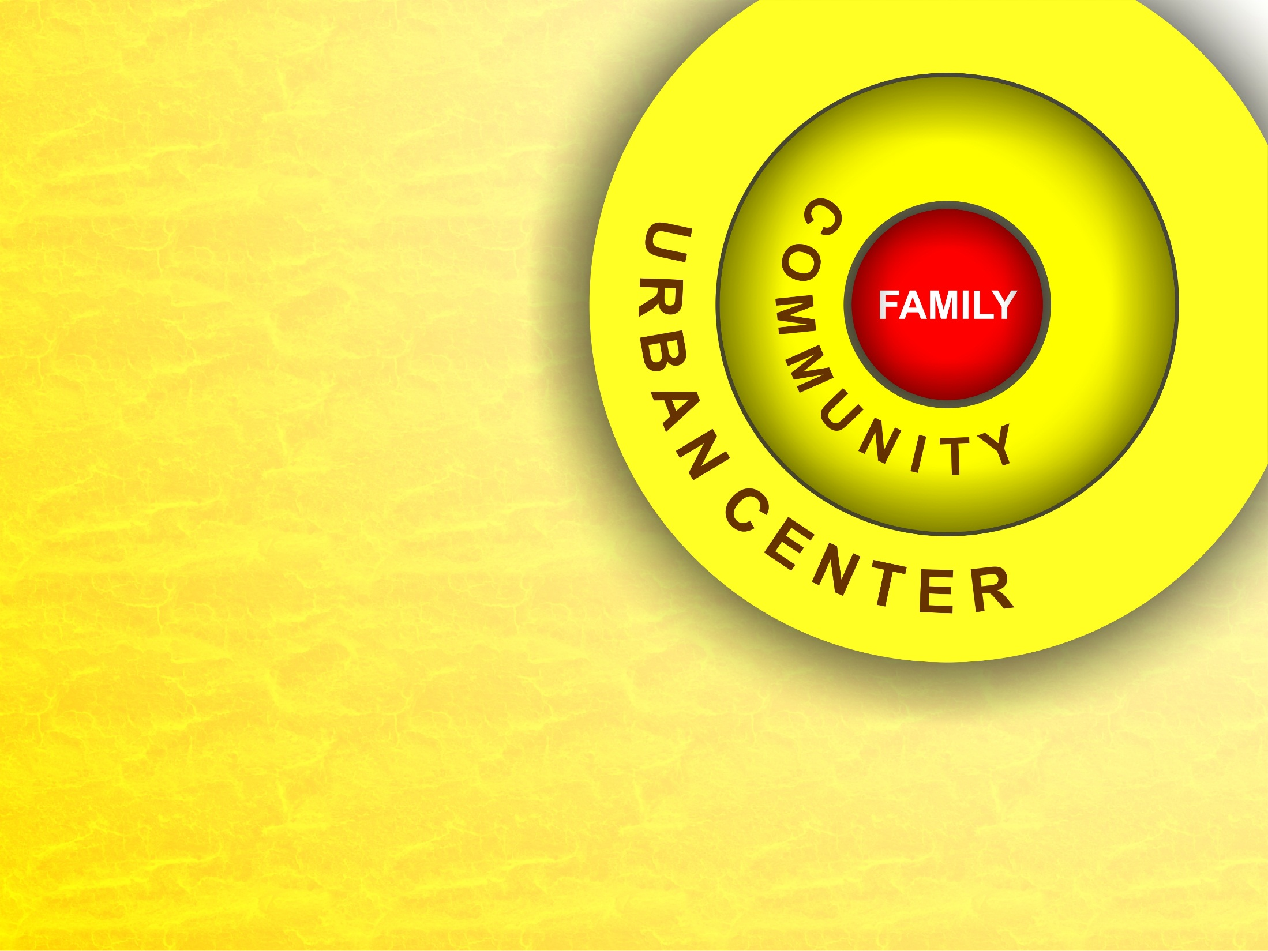
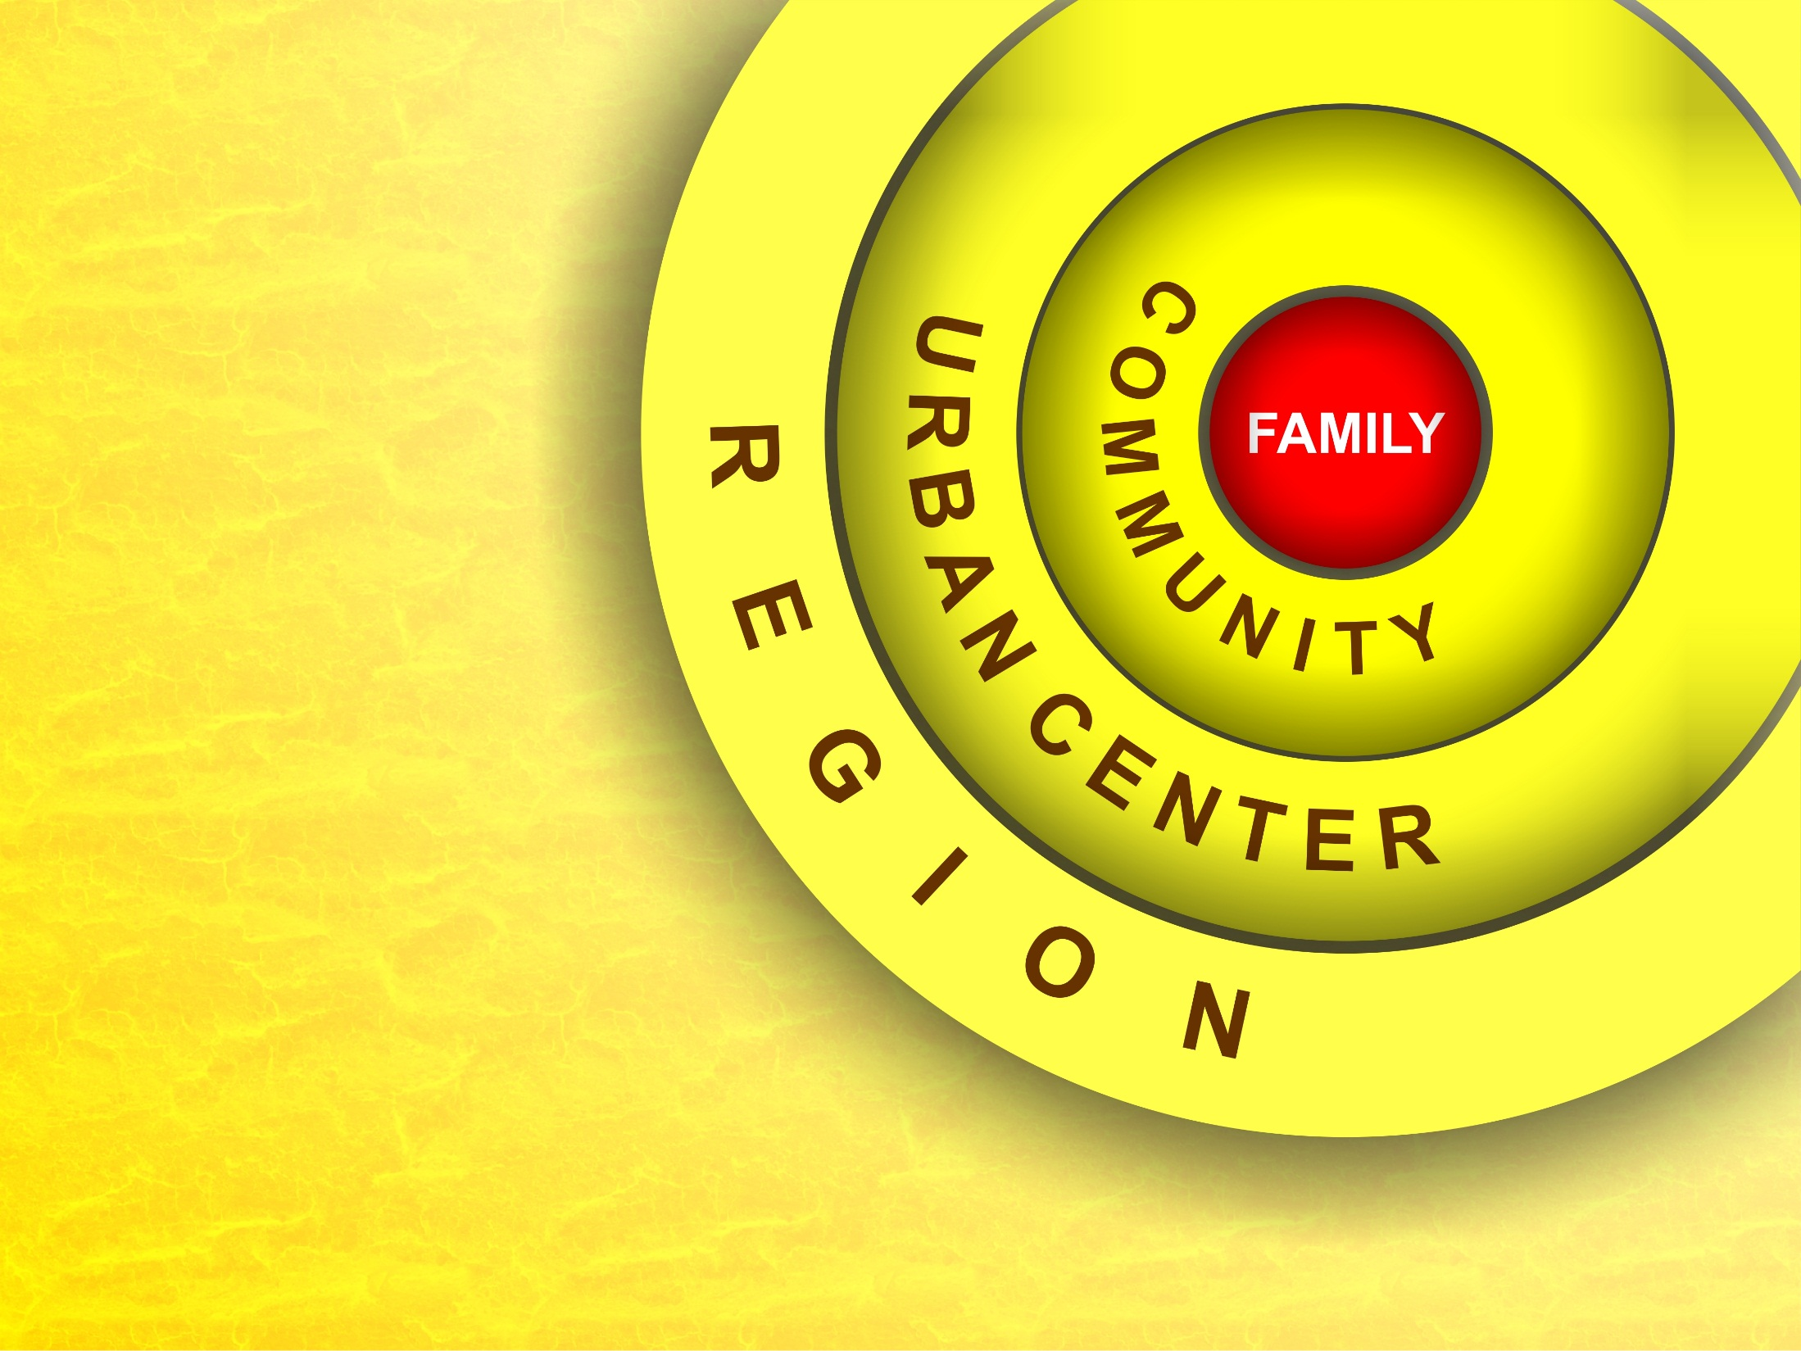
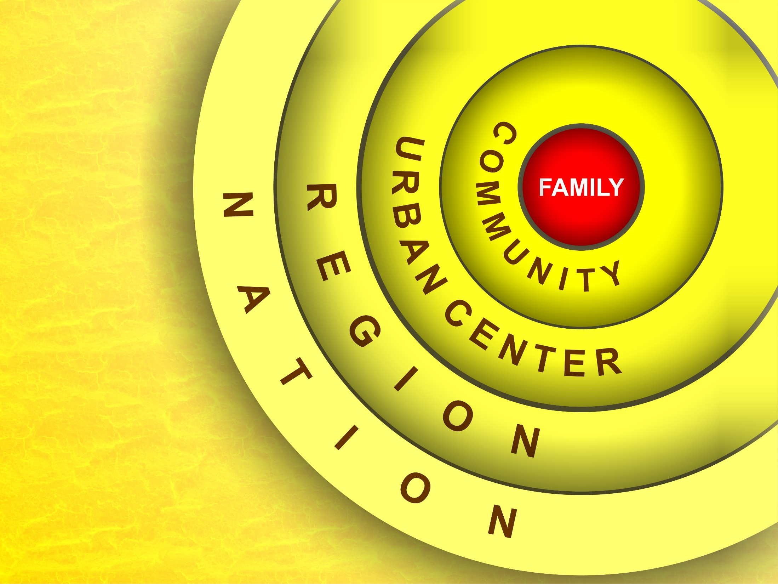
COMMUNITY TRANSFORMATION

